Slide 1

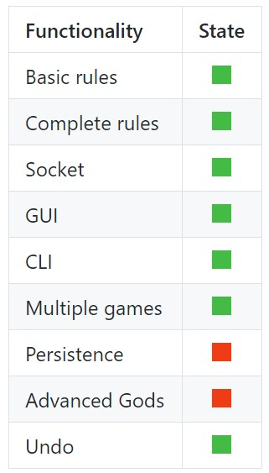
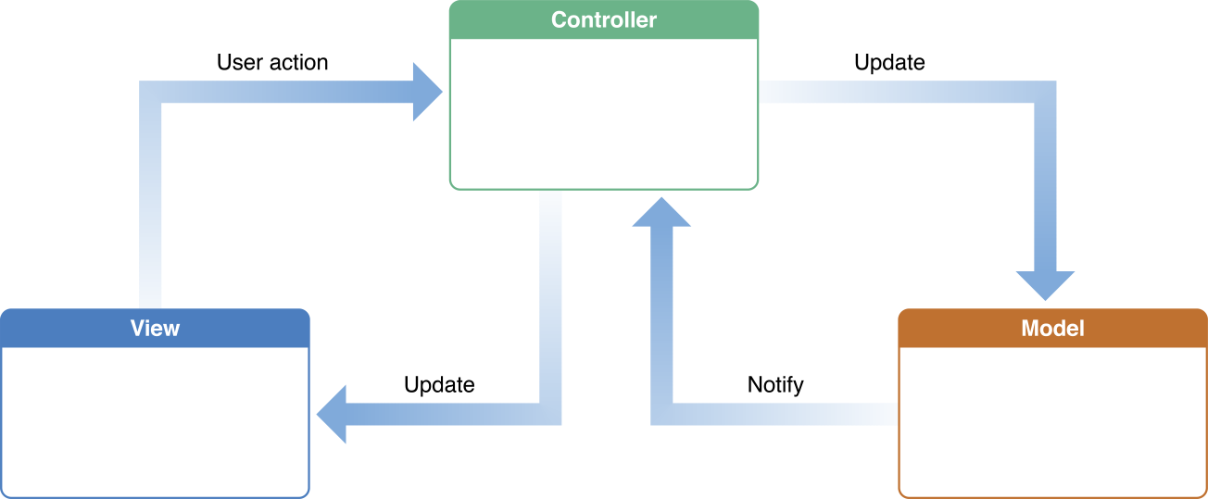






INTRODUCTION
MODEL
CONTROLLER
NETWORK
VIEW
GITHUB
project
MVC
graphs
actions
FA1
ICR
command
& checks
INA
structure
FA2
CLI
GUI
CI
codecov
Notes:
La struttura del nostro MVC

Slide 2
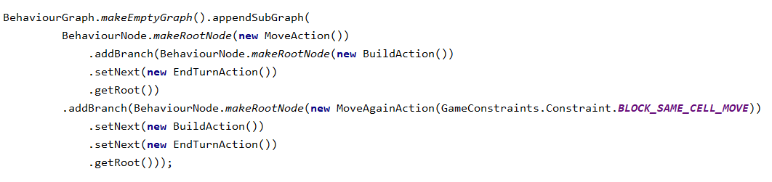
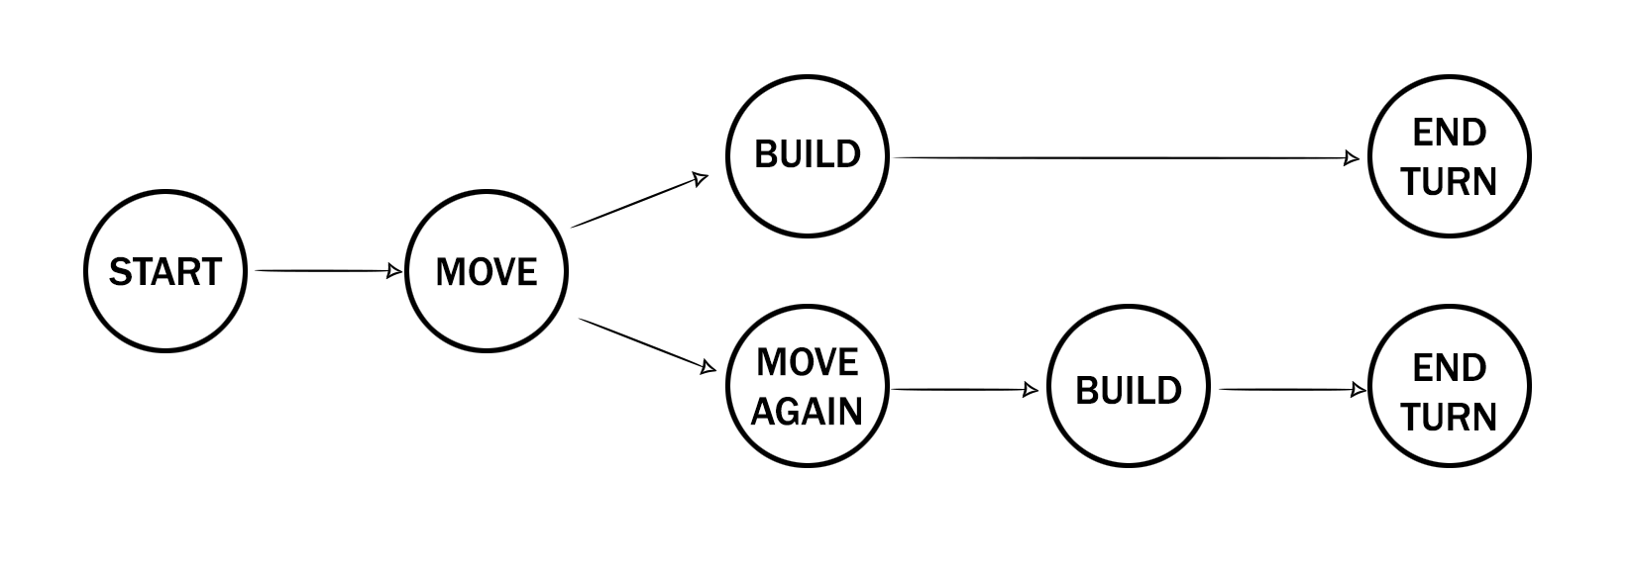
INTRODUCTION
MODEL
CONTROLLER
NETWORK
VIEW
GITHUB
project
MVC
graphs
actions
FA1
ICR
command
& checks
INA
structure
FA2
CLI
GUI
CI
codecov
Notes:
Esempio di un grafo/dio/turno, in questo caso ARTEMIDE

Slide 3
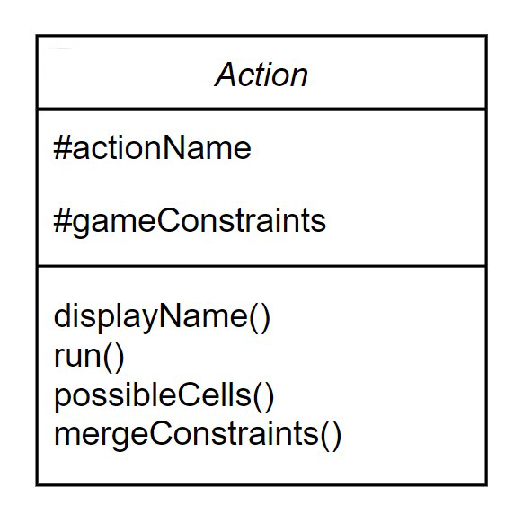

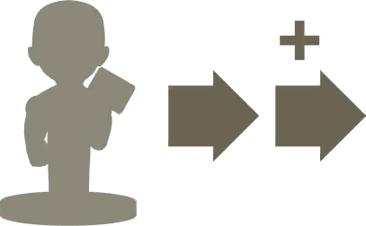




INTRODUCTION
MODEL
CONTROLLER
NETWORK
VIEW
GITHUB
project
MVC
graphs
actions
FA1
ICR
command
& checks
INA
structure
FA2
CLI
GUI
CI
codecov

Slide 4
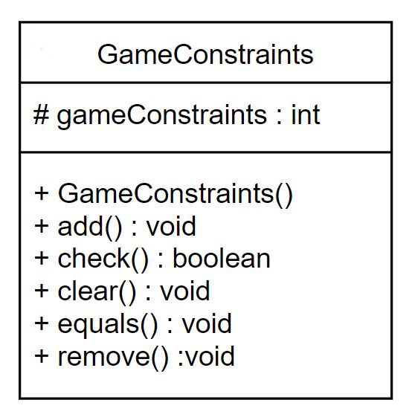
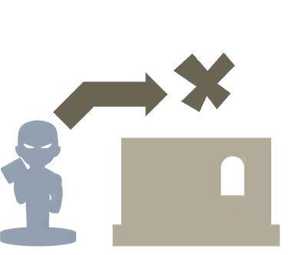





BLOCK_MOVE_UP CAN_PUSH WIN_BY_FALL
BLOCK_SAME_CELL_MOVE SET_BLOCK_MOVE_UP CAN_SWAP
INTRODUCTION
MODEL
CONTROLLER
NETWORK
VIEW
GITHUB
project
MVC
graphs
actions
FA1
ICR
command
& checks
INA
structure
FA2
CLI
GUI
CI
codecov

Slide 5
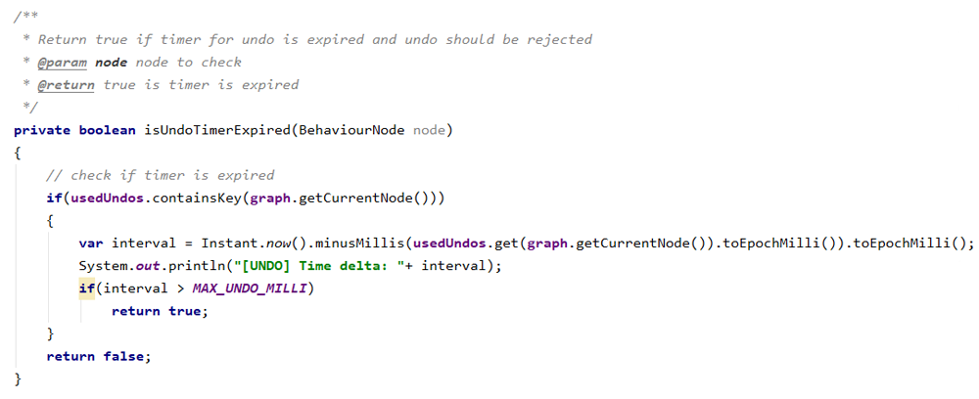
BLOCK_MOVE_UP CAN_PUSH WIN_BY_FALL
BLOCK_SAME_CELL_MOVE SET_BLOCK_MOVE_UP CAN_SWAP
INTRODUCTION
MODEL
CONTROLLER
NETWORK
VIEW
GITHUB
project
MVC
graphs
actions
FA1
ICR
command
& checks
INA
structure
FA2
CLI
GUI
CI
codecov

Slide 6
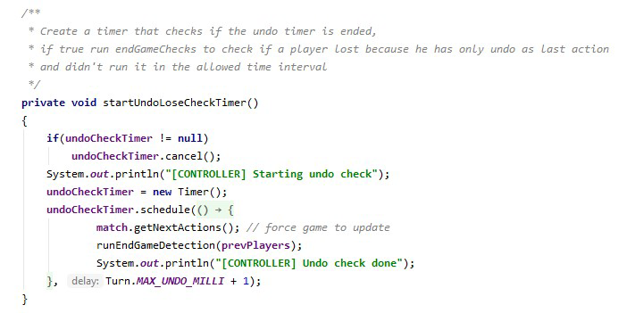
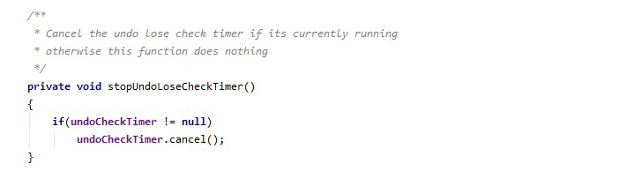
INTRODUCTION
MODEL
CONTROLLER
NETWORK
VIEW
GITHUB
project
MVC
graphs
actions
FA1
ICR
command
& checks
INA
structure
FA2
CLI
GUI
CI
codecov

Slide 7
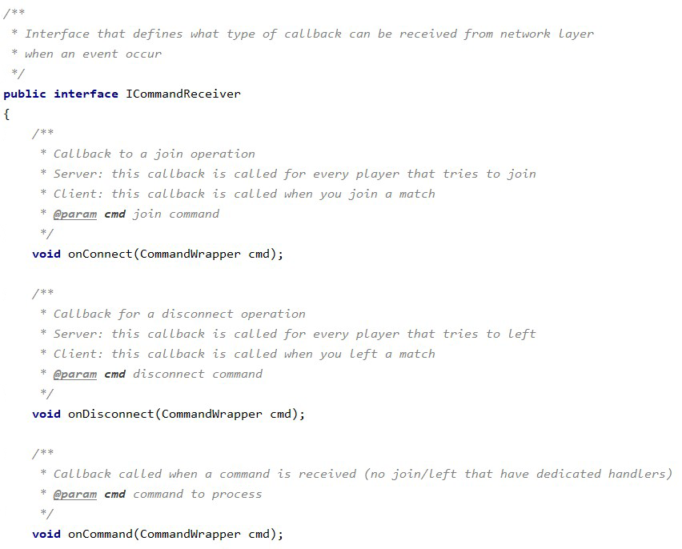
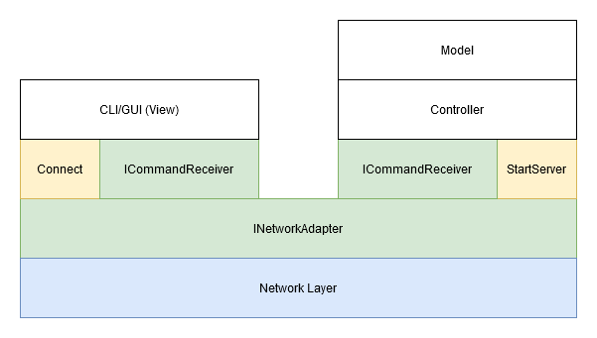
INTRODUCTION
MODEL
CONTROLLER
NETWORK
VIEW
GITHUB
project
MVC
graphs
actions
FA1
ICR
command
& checks
INA
structure
FA2
CLI
GUI
CI
codecov

Slide 8
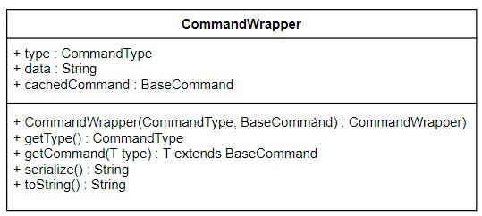
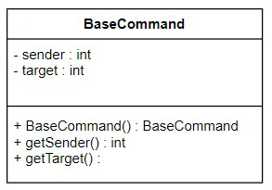
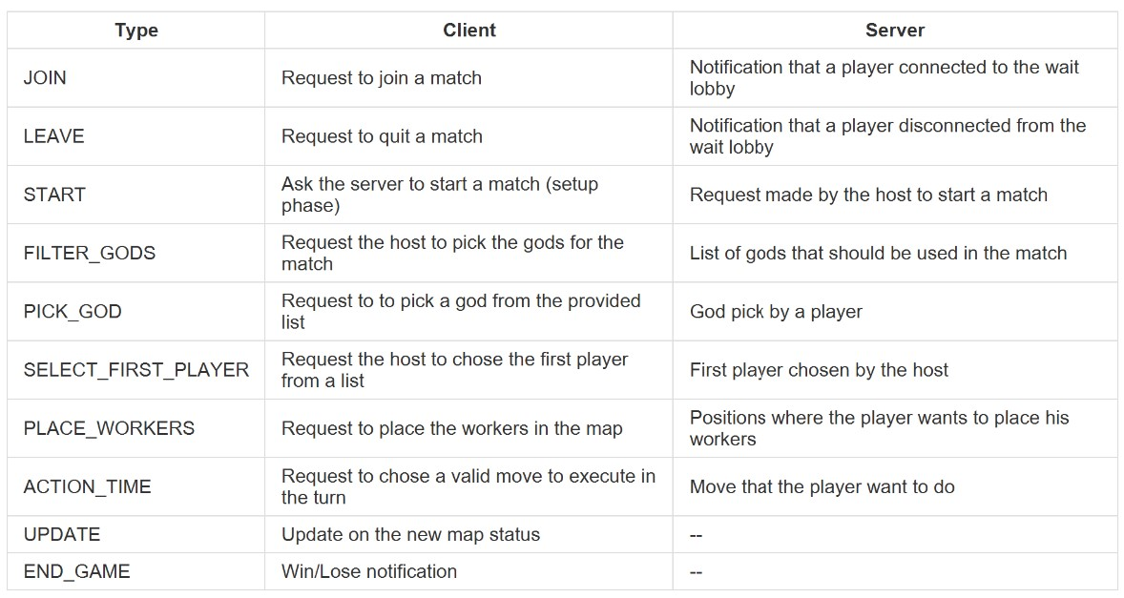
ERROR CHECKING
no ack needed, thanks TCP
expected player check
re-send if something goes wrong
INTRODUCTION
MODEL
CONTROLLER
NETWORK
VIEW
GITHUB
project
MVC
graphs
actions
FA1
ICR
command
& checks
INA
structure
FA2
CLI
GUI
CI
codecov

Slide 9
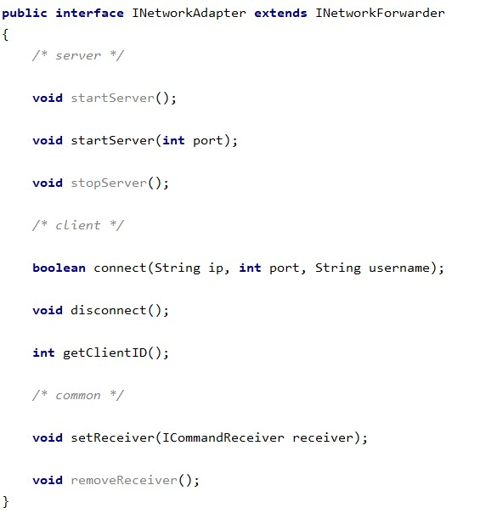
ERROR CHECKING
no ack needed, thanks TCP
expected player check
re-send if something goes wrong
INTRODUCTION
MODEL
CONTROLLER
NETWORK
VIEW
GITHUB
project
MVC
graphs
actions
FA1
ICR
command
& checks
INA
structure
FA2
CLI
GUI
CI
codecov

Slide 10
S
E
R
V
E
R
Disconnection Task
Ping Task
ClientHandler
Client
Disconnection Task
Ping Task
ClientHandler
Client
Disconnection Task
Ping Task
ClientHandler
Client
INTRODUCTION
MODEL
CONTROLLER
NETWORK
VIEW
GITHUB
project
MVC
graphs
actions
FA1
ICR
command
& checks
INA
structure
FA2
CLI
GUI
CI
codecov

Slide 11
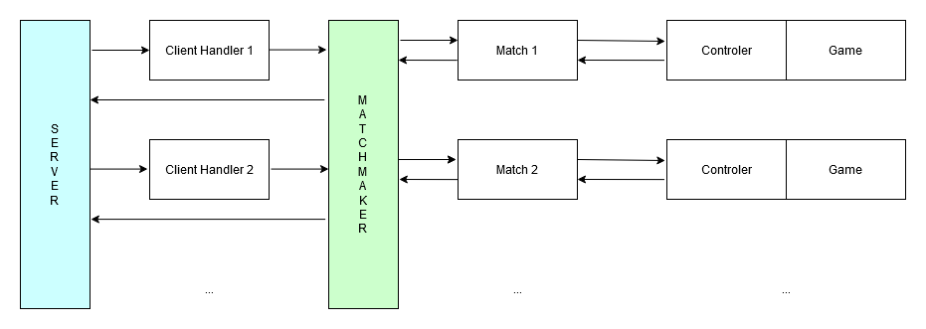
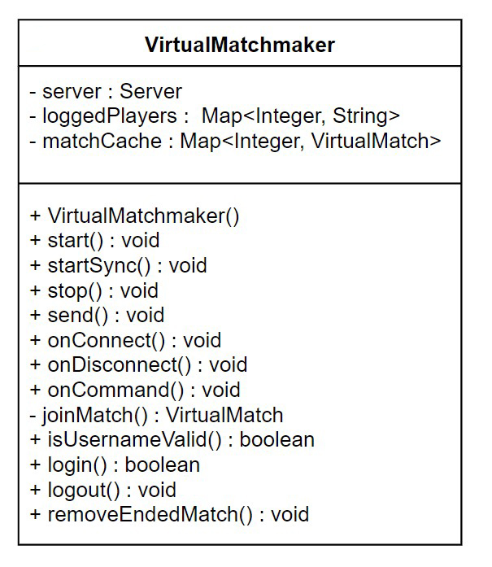
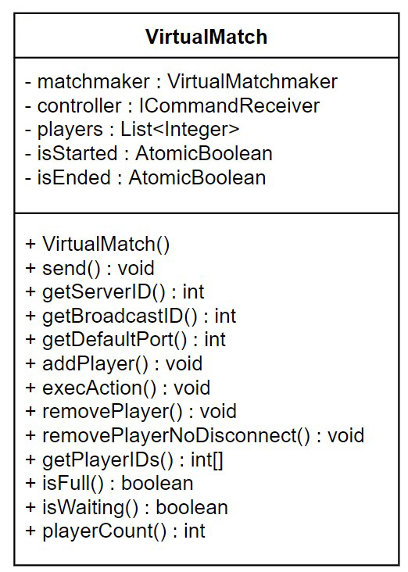
S
E
R
V
E
R
Disconnection Task
Ping Task
ClientHandler
Client
Disconnection Task
Ping Task
ClientHandler
Client
Disconnection Task
Ping Task
ClientHandler
Client
INTRODUCTION
MODEL
CONTROLLER
NETWORK
VIEW
GITHUB
project
MVC
graphs
actions
FA1
ICR
command
& checks
INA
structure
FA2
CLI
GUI
CI
codecov

Slide 12

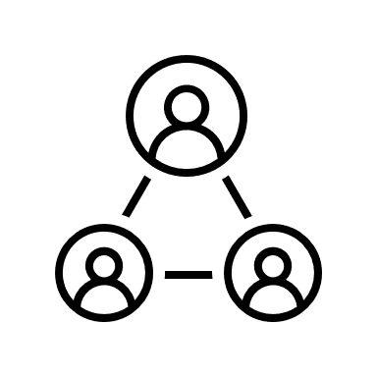
CLI
_synchronized_
matchState
lastCompactMap
availablePositions
nextActions
get
set
INPUT
THREAD
NETWORK
THREAD
cmdNotify
(AtomicBoolean)
INTRODUCTION
MODEL
CONTROLLER
NETWORK
VIEW
GITHUB
project
MVC
graphs
actions
FA1
ICR
command
& checks
INA
structure
FA2
CLI
GUI
CI
codecov

Slide 13
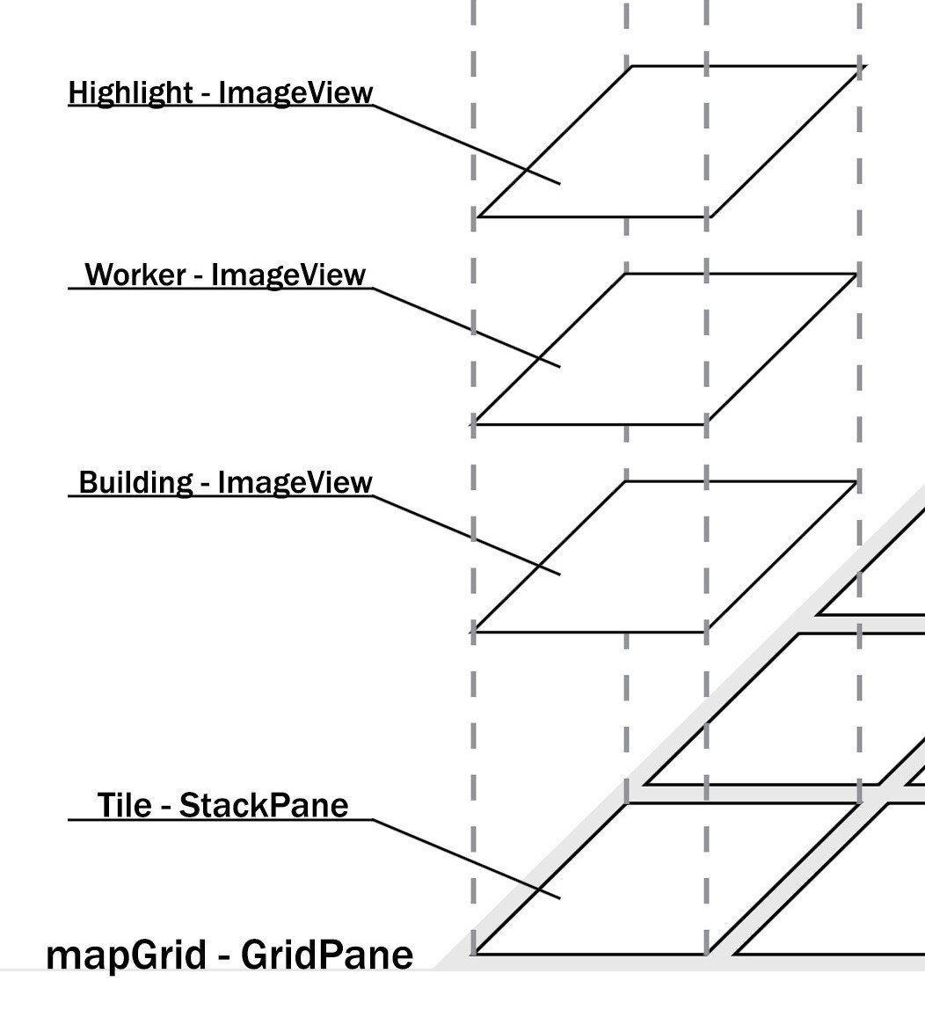
CLI
GuiManager Tools Game Scene
_synchronized_
matchState
lastCompactMap
availablePositions
nextActions
get
set
mainSceneController
settingsSceneController
loginSceneController
waitingSceneController
chooseGodsSceneController
firstPlayerPickSceneController
gameSceneController
endGameSceneController
SceneBuilder
.css files
INPUT
THREAD
NETWORK
THREAD
cmdNotify
(AtomicBoolean)
INTRODUCTION
MODEL
CONTROLLER
NETWORK
VIEW
GITHUB
project
MVC
graphs
actions
FA1
ICR
command
& checks
INA
structure
FA2
CLI
GUI
CI
codecov

Slide 14

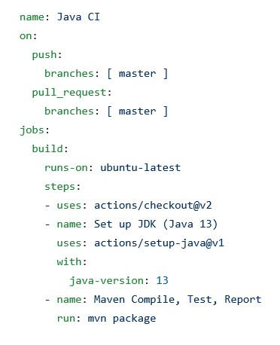
GuiManager Tools Game Scene
mainSceneController
settingsSceneController
loginSceneController
waitingSceneController
chooseGodsSceneController
firstPlayerPickSceneController
gameSceneController
endGameSceneController
SceneBuilder
.css files
INTRODUCTION
MODEL
CONTROLLER
NETWORK
VIEW
GITHUB
project
MVC
graphs
actions
FA1
ICR
command
& checks
INA
structure
FA2
CLI
GUI
CI
codecov

Slide 15
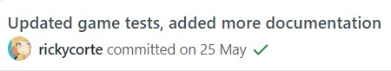
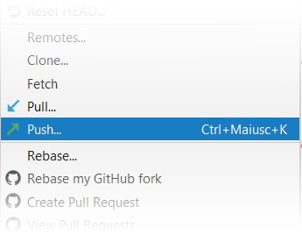
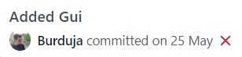
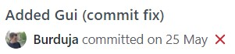
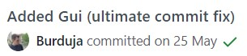



INTRODUCTION
MODEL
CONTROLLER
NETWORK
VIEW
GITHUB
project
MVC
graphs
actions
FA1
ICR
command
& checks
INA
structure
FA2
CLI
GUI
CI
codecov

Slide 16
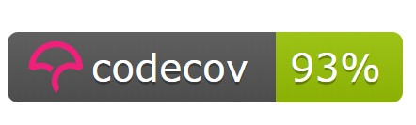
INTRODUCTION
MODEL
CONTROLLER
NETWORK
VIEW
GITHUB
project
MVC
graphs
actions
FA1
ICR
command
& checks
INA
structure
FA2
CLI
GUI
CI
codecov

Slide 17
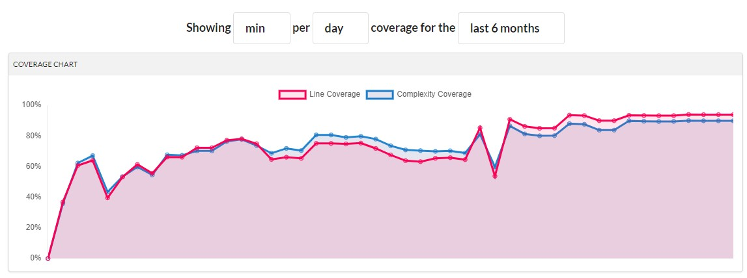
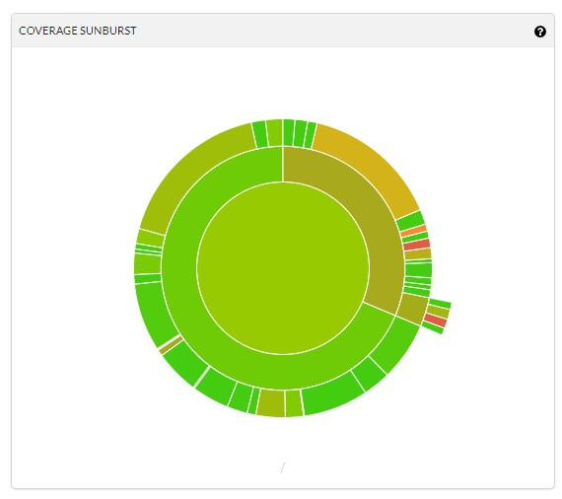
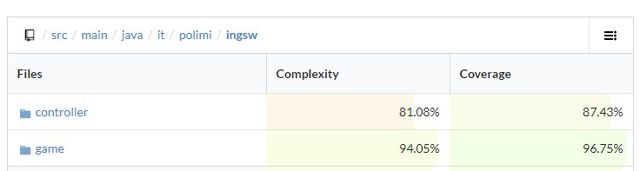
INTRODUCTION
MODEL
CONTROLLER
NETWORK
VIEW
GITHUB
project
MVC
graphs
actions
FA1
ICR
command
& checks
INA
structure
FA2
CLI
GUI
CI
codecov

Slide 18
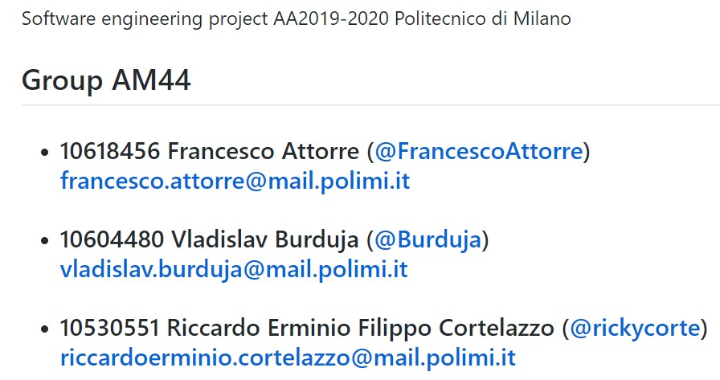
INTRODUCTION
MODEL
CONTROLLER
NETWORK
VIEW
GITHUB
project
MVC
graphs
actions
FA1
ICR
command
& checks
INA
structure
FA2
CLI
GUI
CI
codecov

